Slide 1


Slide 2
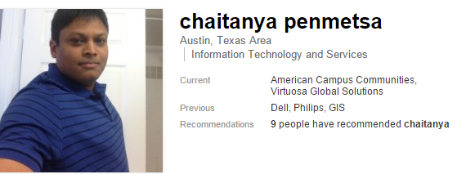
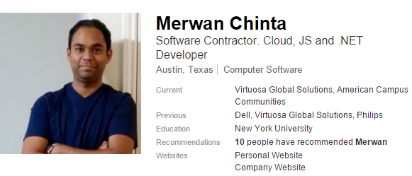
https://www.linkedin.com/in/chaitanyapenmetsa
https://www.linkedin.com/in/merwanchinta

Slide 3
Why NoSQL?
Data Velocity
Data Variety
Data Volume
Data Complexity

Slide 4
NoSQL
Non-relational and scheme-less data model
Low latency and high throughput
Horizontal scalable

Slide 5
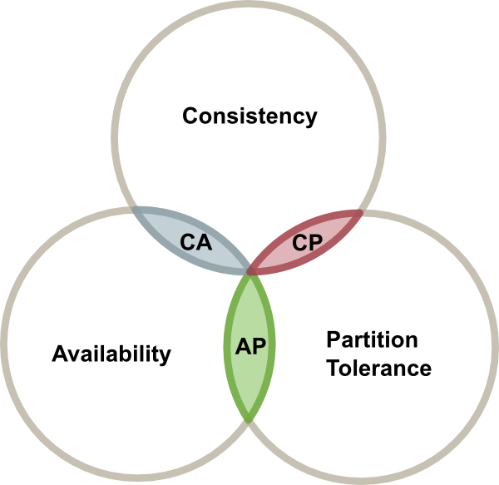
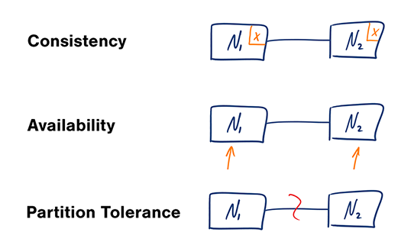
Brewer's Theorem

Slide 6
Considerations when evaluating NoSQL
Data Model
Document model. (DocumentDb, MongoDb)
Graph model. (Neo4j, OrientDB)
Key value model. (Riak and Redis)
Wide column model. (HBase and Cassandra)
Query Model
Document database
Wide column database
Consistency Model
APIs
Community Support and Strength

Slide 7

Azure DocumentDB
NoSQL document database for big data solutions handling JSON data that required easy scaling and high availability.
SQL like syntax
JavaScript execution within the database
Tunable consistency
Fully managed
Elastically scalable throughput with low latency
Open by design

Slide 8
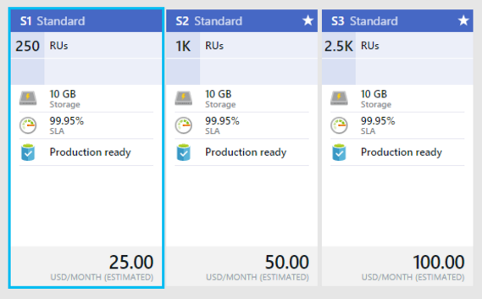
Pricing Quotas and limits

Slide 9
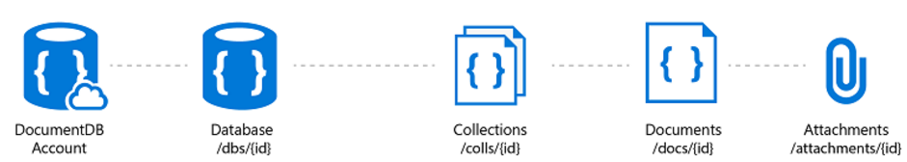
Developing with Azure DocumentDB
.NET SDK NuGet: Microsoft.Azure.DocumentDB
Node.js SDK
Java SDK
JavaScript SDK
Python SDK

Slide 10
Source Code with C# .NET
GIT Clone URL: https://github.com/CheyPenmetsa/AzureAustinDemo.git
Download as ZIP: https://github.com/mingaliu/DocumentDBStudio/archive/master.zip
DocumentDBStudio: https://github.com/mingaliu/DocumentDBStudio

Slide 11
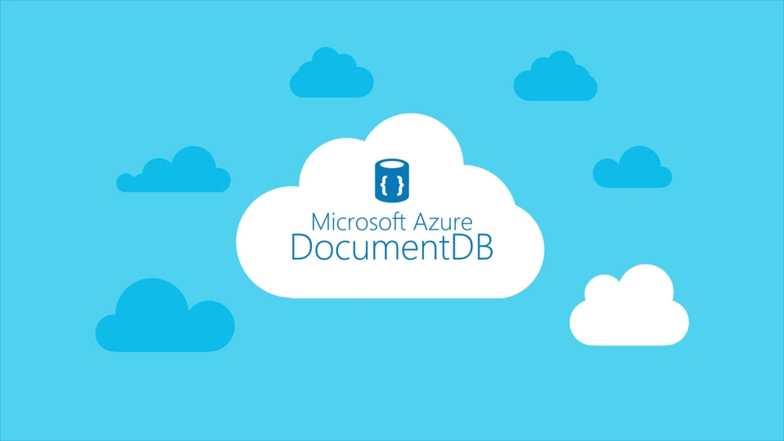
DocumentDB in Action!
By Merwan Chinta and Chaitanya Penmetsa

Slide 12
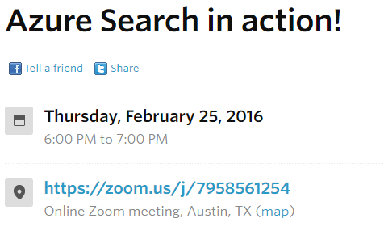
What's Next?

